Slide 1

H172 35 - Object Oriented Analysis and Design
Airline Booking System Initial Class Diagram Example

Slide 2
Airline Booking System CRC Cards

Slide 3
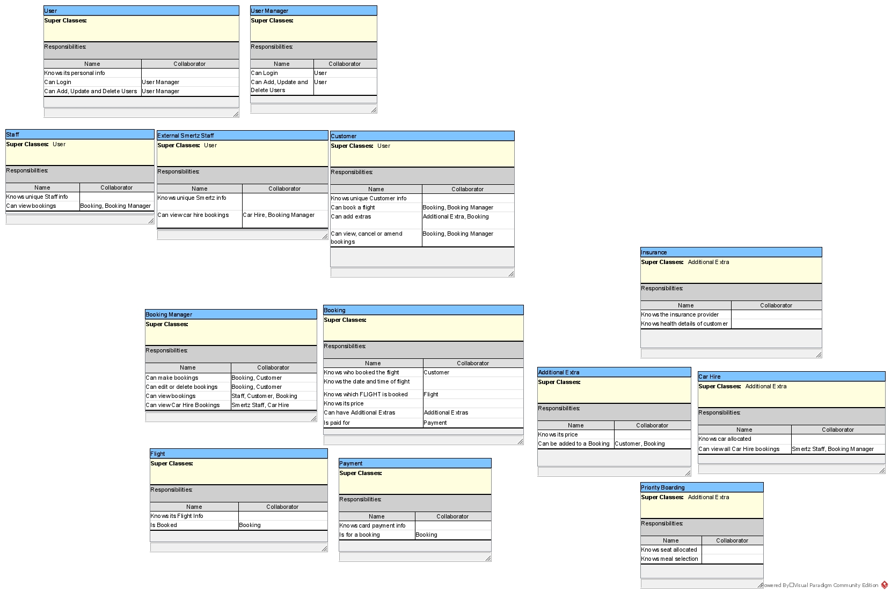

Slide 4
Initial Class Diagram Create Classes from CRC Cards

Slide 6
Initial Class Diagram Spot Missing / Rename Classes

Slide 7
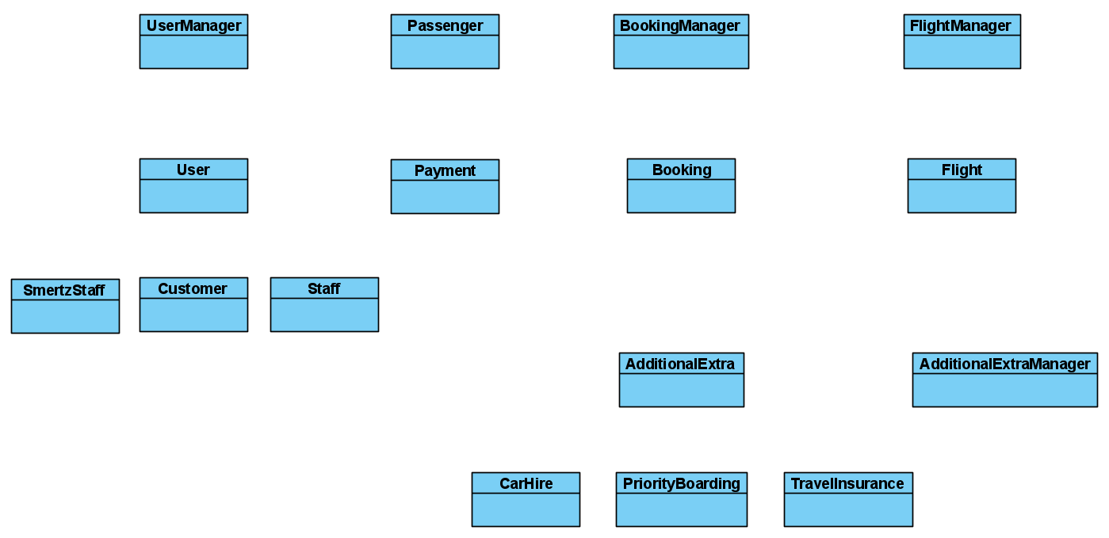
Classes missing from CRC
Renamed from “External Smertz Staff”

Slide 8
Initial Class Diagram Draw Inheritance

Slide 9


Slide 10
Initial Class Diagram Draw Association

Slide 11
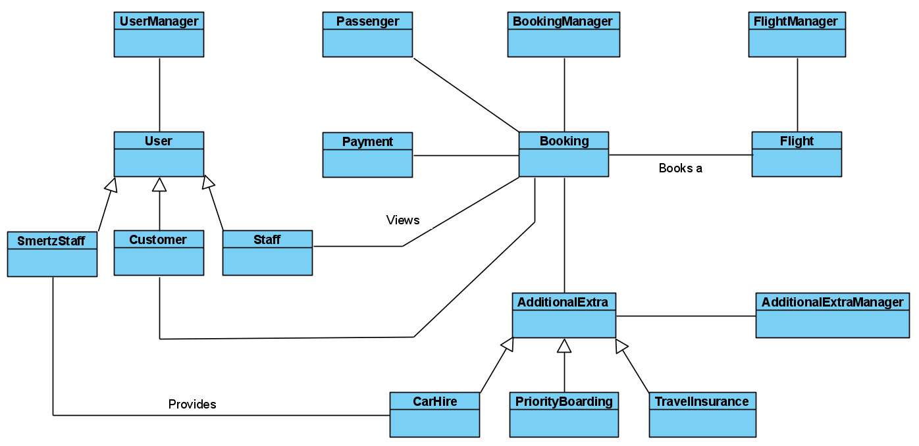

Slide 12
Initial Class Diagram Identify Aggregation / Composition

Slide 13
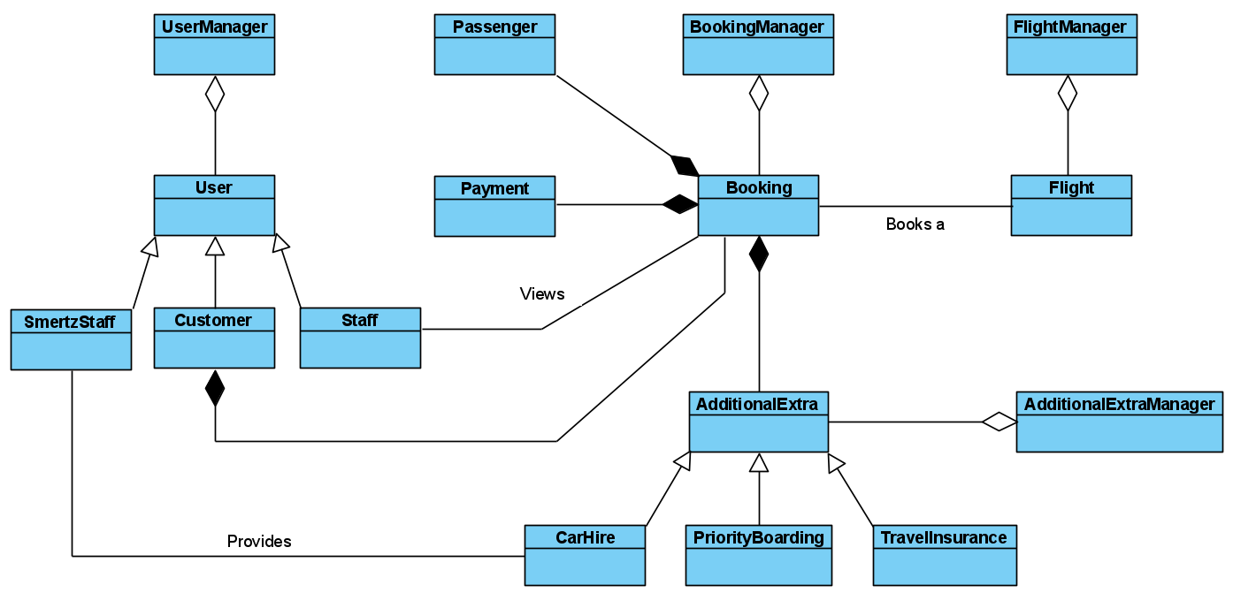


Slide 14
Initial Class Diagram Detail Multiplicity

Slide 15
